Slide 1
Course : COMP8029 – IT Security and Risk Management
Period : September / February 20XX
Network Risk Mitigation – Intrusion Detection
Session 07
KDS – Name SME

Slide 2
Intrusion Detection System (IDS)
An intrusion detection system (IDS) is a device or software application that monitors a network or systems for malicious activity or policy violations.
Any detected activity or violation is typically reported either to an administrator or collected centrally using a security information and event management (SIEM) system.
Intrusion detection system only generate alert.
Bina Nusantara University

Slide 3
Intrusion Detection Systems (continued)
Alert or alarm:
  An indication that a system has been attacked or continues to be attacked
  May be audible signals, email messages, pager notifications, pop-up windows, or log entries
False attack stimulus: an event that triggers alarms and causes a false positive
False negative: failure of an IDS to react to an actual attack; most grievous type of failure
Bina Nusantara University

Slide 4
Intrusion Detection Systems (continued)
False positive:
  An alarm or alert when no attack occurred
  Tends to make users insensitive to alarms
Noise:
  Ongoing activity from alarm events that are accurate and noteworthy but not necessarily significant as potentially successful attacks
  Unsuccessful attacks are the most common source of noise
Bina Nusantara University

Slide 5
Why Use an IDS?
Compelling reasons to use an IDS:
  Prevent problem behaviors by increasing the perceived risk of discovery and punishment
  Detect attacks and security violations that are not prevented by other security measures
  Detect and deal with preambles to attacks (network probes and other doorknob-rattling activities)
  Document the existing threat to an organization
  Act as quality control for security design and administration
  Provide intrusion data to improve diagnosis and recovery
Bina Nusantara University

Slide 6
Why Use an IDS? (continued)
Most attacks begin with an organized and thorough probing of an organization’s network and defenses
Doorknob rattling: probing for the initial estimate of the defensive state of networks and systems
Footprinting: gathering information about network activities and assets
Fingerprinting: scanning for active systems and services offered by those systems
IDS may allow administrators extra time to prepare for an attack
Bina Nusantara University

Slide 7
Why Use an IDS? (continued)
Data collected by an IDS can be used to document threats faced by an organization and justify the cost of security technology
IDS can also be justified using the concept of Defense in Depth, to help identify emergent or residual flaws in current security and network architecture
IDS also provides data for post attack reviews and forensic information
Bina Nusantara University

Slide 8
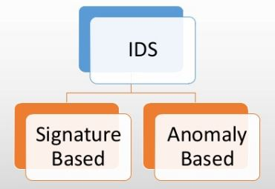
Type of IDS
Bina Nusantara University

Slide 9
Signature Based IDS
String matching and Database of pattern or signature
Fails to identify zero day attacks
Examines data traffic for patterns that match known signatures of attack patterns
Must be continually updated as new attack strategies are identified
Methods are similar to antivirus software
Signatures include time considerations: how frequently an attack pattern is expected
Is vulnerable to slowly timed attacks
Bina Nusantara University

Slide 10
Anomaly Based IDS
Monitor network traffic and compares it against an established baseline for normal use and classifying it as either normal or anomalous.
Based on rules, rather than patterns or signatures
High false positive rate
Statistical anomaly-based IDS (stat IDS) or behavior-based IDS:
  Collects statistical summaries by observing traffic known to be normal to establish a baseline
Bina Nusantara University

Slide 11
Classification of IDS by Network Placement
IDSs operate as network-based, host-based, or application-based systems
Network-based systems focus on protecting network information assets
Host-based versions focus on protecting the server or host’s information assets
Application-based model works on one or more hosts that support a single application
Bina Nusantara University

Slide 12
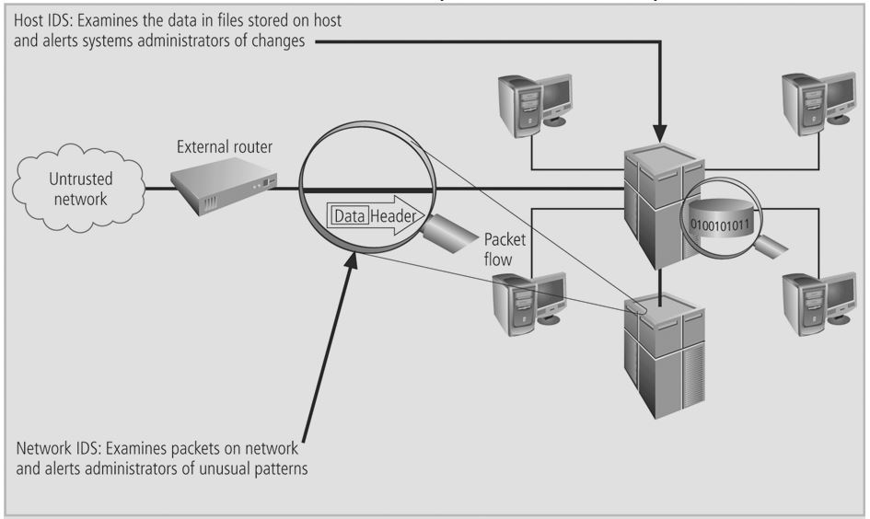
Classification of IDS by Network Placement (continued)
Bina Nusantara University

Slide 13
Network Based (Network IDS)
Network based intrusion detection attempts to identify unauthorized, illicit, and anomalous behavior based solely on network traffic.
A network IDS, using either a network tap, span port, or hub collects packets that traverse a given network.
Using the captured data, the IDS system processes and flags any suspicious traffic.
Looks for patterns within network traffic that indicate an intrusion event is underway
Can detect many more types of attacks than a host-based IDS, but is more complex to configure and maintain
Example: SNORT
Bina Nusantara University

Slide 14
Network Based (Network IDS)
Signature matching:
  Process of comparing measured activity to known signatures to determine if an attack is underway
Protocol stack verification:
  Deals with IP, TCP, UDP protocols
  Looks for malformed data packets
Application protocol verification:
  Deals with higher order protocols (HTTP, FTP, Telnet)
  Looks for unexpected packet behavior or improper use
Bina Nusantara University

Slide 15
Host Based (HIDS)
Often referred to as HIDS, host based intrusion detection attempts to identify unauthorized, illicit, and anomalous behavior on a specific device.
HIDS generally involves an agent installed on each system, monitoring and alerting on local OS and application activity.
The installed agent uses a combination of signatures, rules, and heuristics to identify unauthorized activity.
Example: OSSEC, Tripwire, AIDE, Prelude Hybrid IDS
Bina Nusantara University

Slide 16
Host Based (HIDS)
Host-based IDS (HIDS):
  Resides on a particular computer or server
  Monitors activity only on that host
  Also called system integrity verifiers
  Monitors the status of key system files, system configuration databases (registry, .ini, .cfg, .dat files)
  Sounds an alarm when file attributes change, new files are created, or existing files are deleted
  Can also monitor system logs
HIDS relies on the classification of files into various categories
Bina Nusantara University

Slide 17
Host Based (HIDS)
Managed HIDS can monitor multiple computers simultaneously
  Each HIDS reports to a master console system
Files are usually categorized into these levels:
  Critical system components: system registry and folders containing key OS elements
  Support components: device drivers and other relatively important files
  User data
Bina Nusantara University

Slide 18
Application Based
Application-based IDS (AppIDS): monitors an application for abnormal events such as:
  Users exceeding their authorization
  Invalid file executions
  Problems in the normal interaction between users, the applications, and the data
AppIDS can view encrypted data
A blended approach using NIDS, HIDS, and AppIDS may be best
Bina Nusantara University

Slide 19
Physical (Physical IDS)
Physical intrusion detection is the act of identifying threats to physical systems. In many cases physical intrusion detection systems act as prevention systems as well. Examples of Physical intrusion detections are:
  Security Guards
  Security Cameras
  Access Control Systems (Card, Biometric)
  Firewalls
  Man Traps
  Motion Sensors
Bina Nusantara University

Slide 20
Intrusion Prevention
Intrusion prevention follows the same process of gathering and identifying data and behavior, with the added ability to block (prevent) the activity. This can be done with Network, Host, and Physical intrusion detection systems.
A more reactive approach
Based on ability to respond to known methods of attacks and ability to create adaptive responses to previously unknown attacks
Biggest challenge is the tuning of the automated responses to avoid extreme measures with false positives yet still provide protection against attacks
Bina Nusantara University

Slide 21
Honeypot
Honeypot:
  Computer server configured to resemble a production system
  Closely monitored network decoy used to distract adversaries, provide warnings about new attack and exploitation trends, and allow in-depth examination of adversaries during and after exploitation
Honeytoken:
  Bogus file or information placed in a database
  If accessed, it indicates unwanted activity
Bina Nusantara University

Slide 22
Honeynet (or honeypot farm):
  Provides an entire network of real systems, applications, and services for attackers to interact with
  Any inbound activity is most likely a scan, probe, or attack
  Any outbound activity indicates that a system has been compromised
Bina Nusantara University

Slide 23
Legal Issues with honeypots and honeynets:
  Know the difference between enticement (legal) and entrapment (not legal)
  Ensure that anyone connecting to the honeypot or honeynet does not inadvertently place information into the environment (4th Amendment issue)
  Electronic Communications Protection Act: prohibits recording of wire- or cable-based communications unless an exception applies
  Pen Register, Trap and Trace Devices statute: general prohibition of real-time monitoring of traffic data relating to communications
Bina Nusantara University

Slide 24
Wasp trap syndrome: by using a honeypot or honeynet, you may attract more potential attackers
Legal aspects associated with tracking individuals back through the systems of others have yet to be resolved
Must consider the implications of an attack coming from a compromised system and the legality of a counterattack
Bina Nusantara University

